Slide 1
Loading GLATOS Data into R and Filtering False Positive Detections
Review GLATOS data portal
Logging into the data portal
Brief overview of tools and services available in the data portal
Retrieving data from the GLATOS data portal
Load data from the GLATOS export into R
read_glatos_detections
read_glatos_receivers
read_glatos_workbook
Filter the resulting detections data frame using the false_detection filter function

Slide 2
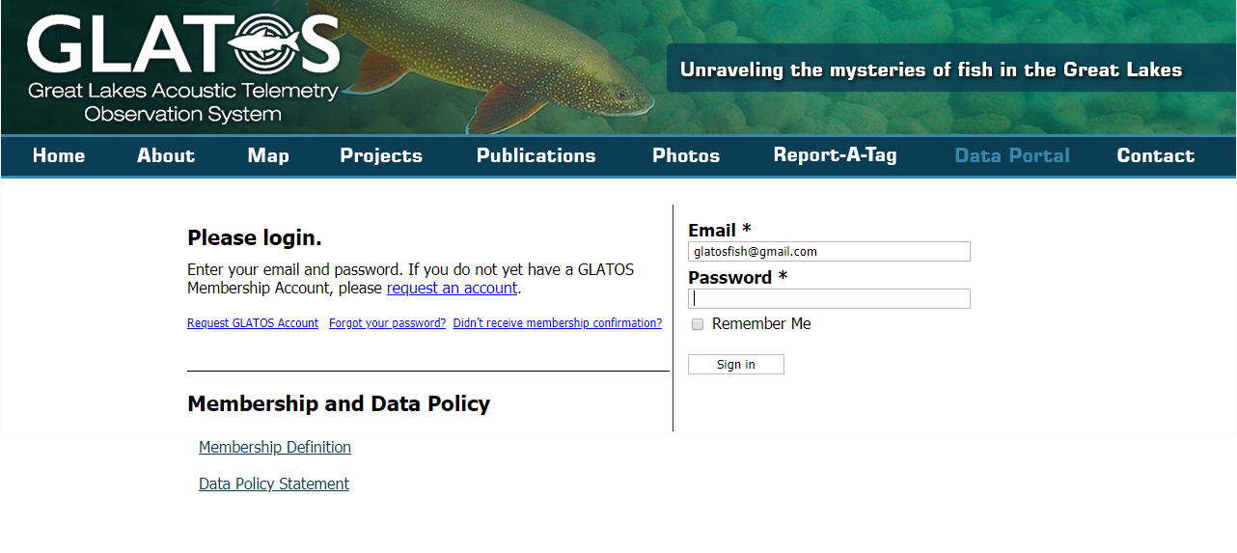
Retrieving GLATOS export from data portal (glatos.glos.us/portal)
Don’t have a project yet?
Log in as glatosfish@gmail.com
PW: glatostest

Slide 3
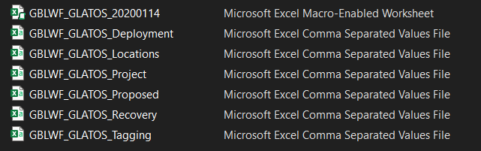
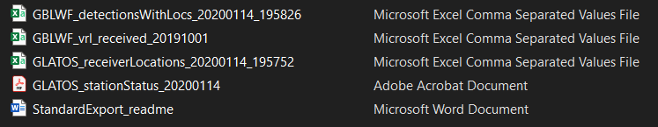
Contents of GLATOS Detections Export
glatos R package built around these three files
GLATOS WEB

Slide 4
“glatos” Load Functions
The glatos r-package contains functions designed to load data files in standardized formats from GLATOS and OTN.
Data load functions facilitate fast and efficient loading of data into R
Consistent formatting that conforms to requirements of other functions in the glatos R-package (e.g., summarize_detections, detection_bubble_plot)
See also data requirements and data loading vignettes

Slide 5
“glatos” Load Functions
read_glatos_detections
Input: detection data from standard GLATOS detection export files
read_glatos_workbook
read_glatos_receivers
Output: data frame object of class “glatos_detections” with 30 columns
Input: GLATOS network receiver deployment metadata from GLATOS export package (e.g., “GLATOS_receiverLocations_20191004_151251.csv”)
Input: standard GLATOS project workbook (*.xlsm file).
Output: list of class “glatos_workbook” with three elements: 1) “metadata” (project metadata), 2) “animals” (tagging metadata), and 3) “receivers” (combined deployment and recovery data).
Process: converts timestamps to class “POSIXct” and dates to class “Date”
Output: : data frame object of class “glatos_receivers” with 23 columns
Process: converts timestamps to class “POSIXct” :
Process: Combines “Deployment” and “Recovery” worksheets, converts timestamps to “POSIXct”

Slide 6
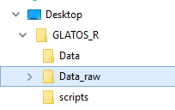
“glatos” Load Functions
Create or identify a local working directory to store unprocessed (raw) data files. Copy the file path to that directory. Use setwd(“path”) to set the working directory

Slide 7
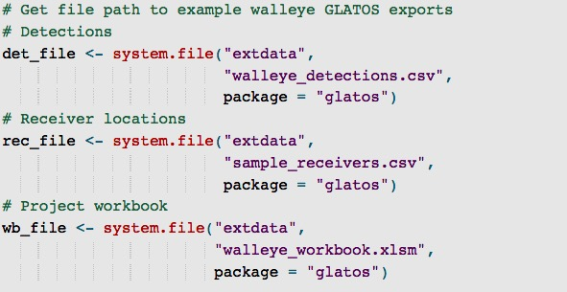
“glatos” Load Functions
“glatos” r-package includes example data accessed using system.file

Slide 8
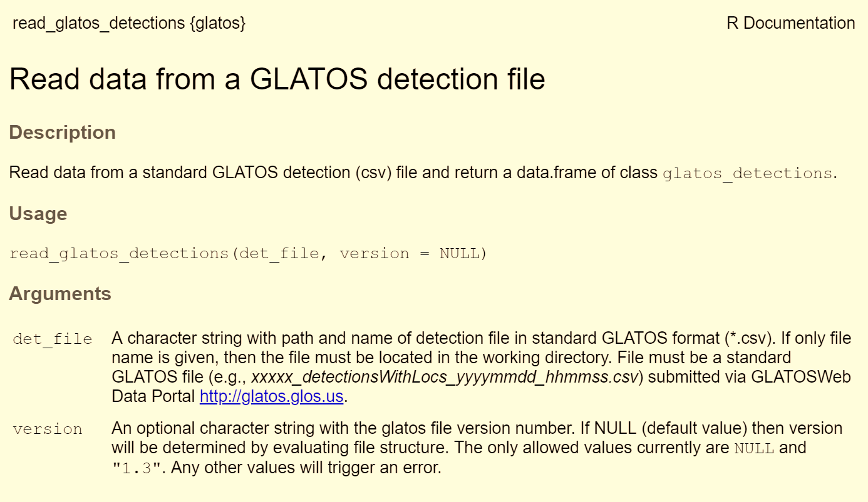
Load GLATOS Detection Data
?read_glatos_detections
Arguments without default values are required, those with defaults are optional

Slide 9
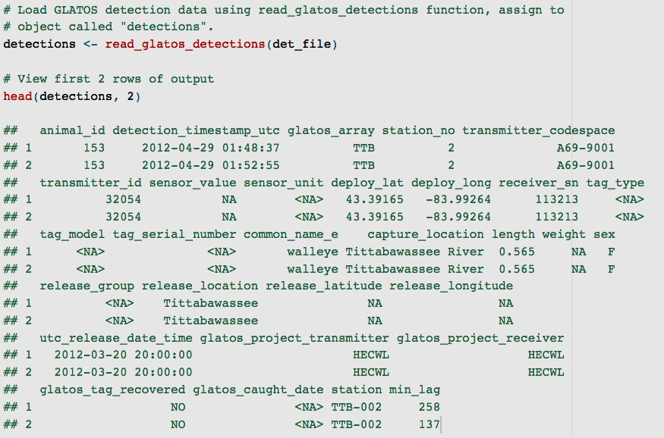
pg: 62
Load GLATOS Detection Data

Slide 10
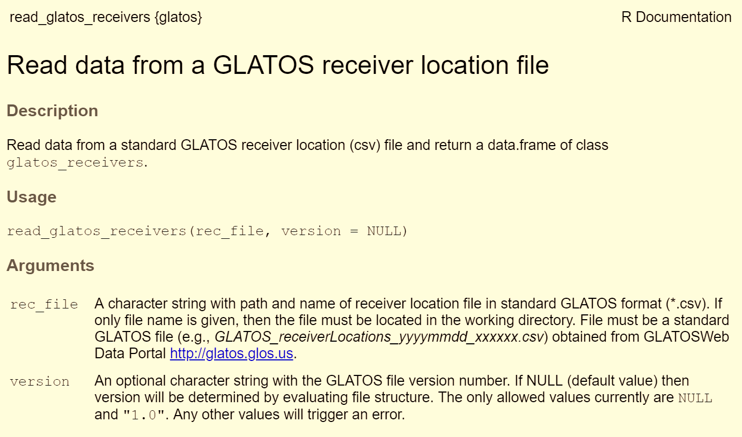
pg: 62
Load GLATOS Receiver Locations
?read_glatos_receivers

Slide 11
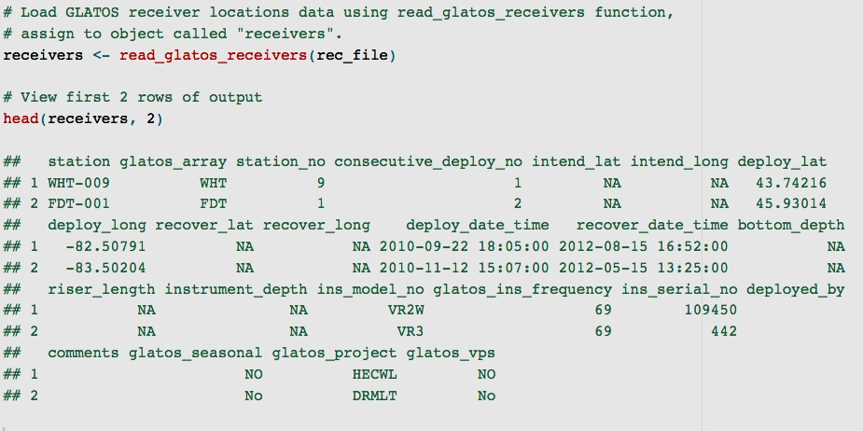
pg: 64
Load GLATOS Receiver Locations

Slide 12
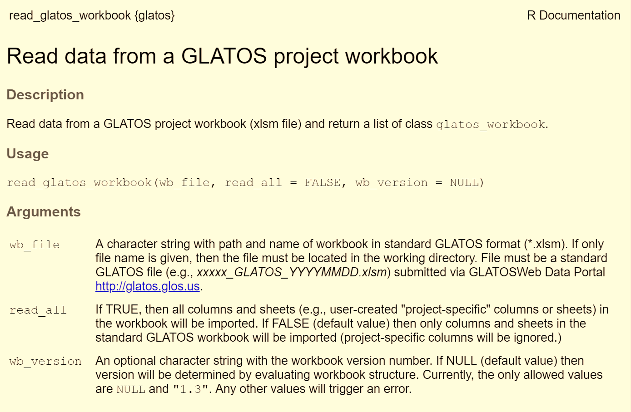
pg: 62
Load GLATOS Project Workbook
?read_glatos_workbook

Slide 13
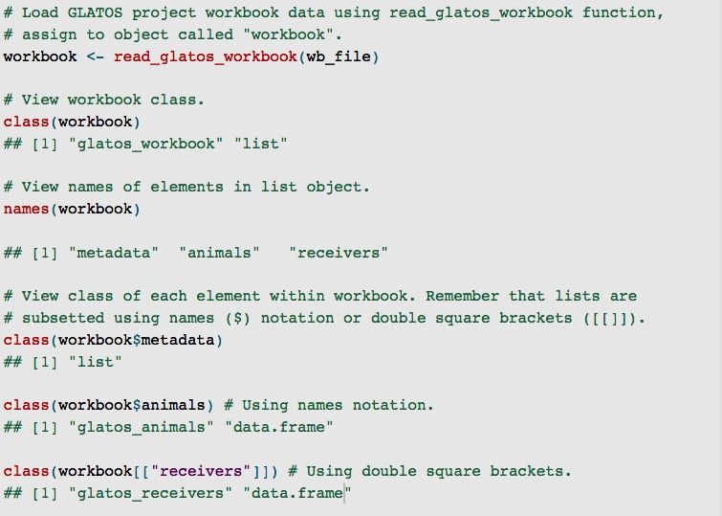
pg: 66
Load GLATOS Project Workbook

Slide 14
pg: 68
Filter Possible False Detections
?false_detections
“false_detections” function identifies potential false detections based on short interval criterion (Pincock 2012 - https://www.vemco.com/pdf/false_detections.pdf)
Probability of getting two false detections for the same transmitter on the same receiver in a short interval of time is very small
“min_lag” column in the detection export is the shortest time interval between successive detections on the same receiver – must be less than user-defined “tf” to pass the filter
Common rule of thumb for “tf” for VEMCO PPM encoded transmitters is 30 times the nominal delay (e.g., 3600 s for a transmitter with a 120 s nominal delay; Pincock 2012).
Function returns the glatos_detections data frame with an additional column, ‘passed_filter’, indicating if each detection did (1) or did not (0) pass the filter criterion
“passed_filter” column may be used to subset detections that passed the filter.
Notes:
In the first bullet point, should probably add “on the same receiver” to the end of the statement. [ASIDE: It just occurred to me that current min_lag function is applied on a receiver by receiver basis, but perhaps it should work at the level of “station”, as it is conceivable that detections occurring around the time when receivers are swapped out could be flagged as potentially false because they would occur on different receivers (even though the detections are from the same location)?. Maybe this would be such a rare occurrence that it’s not worth incorporating into the calculation. Worth at least bringing it up with Holbrook I think].
I’d be prepared for the question why 30 times the nominal delay is recommended.

Slide 15
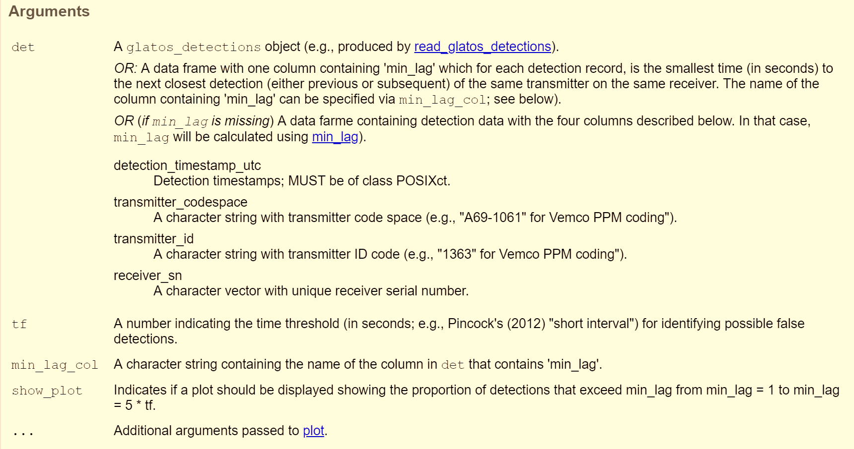
pg: 68
Filter Possible False Detections
detections data frame
false_detections
detections data frame with appended column “passed_filter”
+ optional plot of min lag distributions

Slide 16
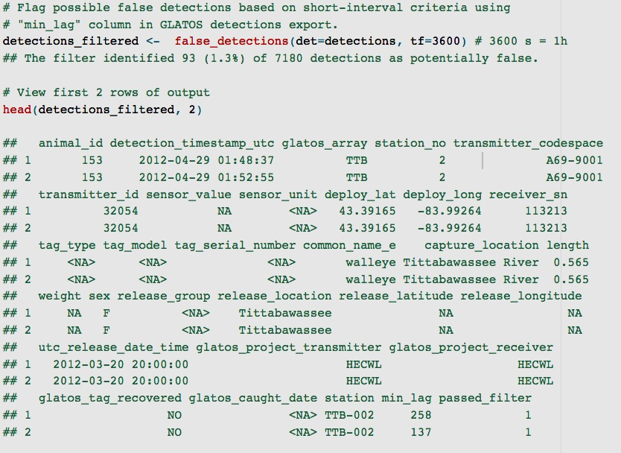
pg: 68
Filter Possible False Detections

Slide 17
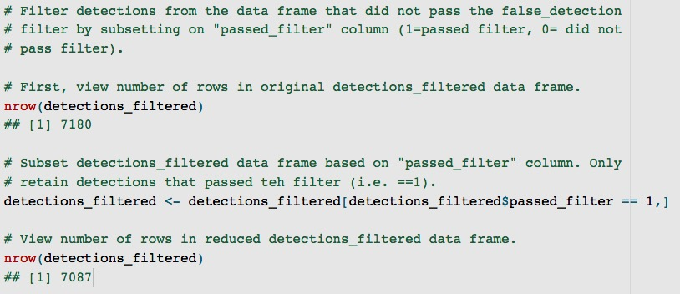
pg: 68
Filter Possible False Detections
”passed_filter” column can be used to filter out false positive detections.

Slide 18
pg: 69-81
Quick Summaries and Data Visualization
Detection data at a glance: tabular summaries of detections
summarize_detections function
Reducing detections to detection events: making a file that is useable in programs like Microsoft Excel
detection_events function
Quick plots for visualizing detections: individual detection histories and spatial distribution of fish
abacus_plot function
detection_bubble_plot function
Play time!
Apply summarization and visualization functions to your own detection data
Play with the various function options

Slide 19
pg: 69
Tabular Summaries of Detections
summarize_detections function provides users with quick tabular summaries of their detection data
Has options for customizing the output:
Location grouping variable - existing field in the glatos detection export file (e.g., glatos_array) OR a custom field added to the detections data frame by the user (e.g., basin, reef)
Type of output – summarize detections by animal_id, location, or both
Specify animal_ids and locations to be included in the summaries

Slide 20
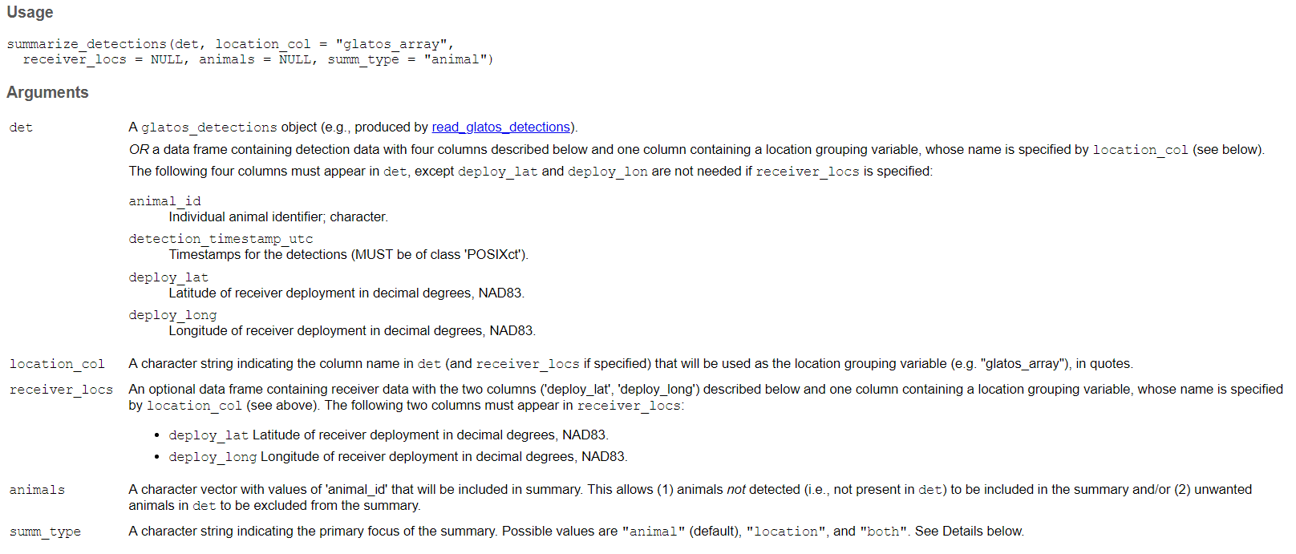
pg: 69
Tabular Summaries of Detections
glatos detections data frame (created using read_glatos_detections)
summarize_detections
data frame summarizing detections by “animal_id” OR location identifier OR both

Slide 21
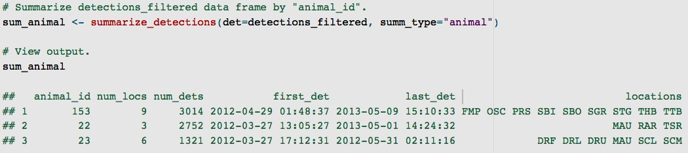
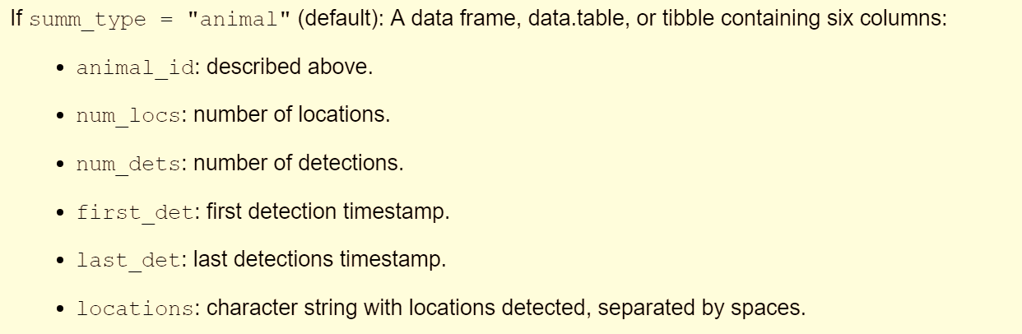
pg: 69
Tabular Summaries of Detections
1. Summarize by “animal”
Note: Because “animal” is default, this argument is not necessary

Slide 22
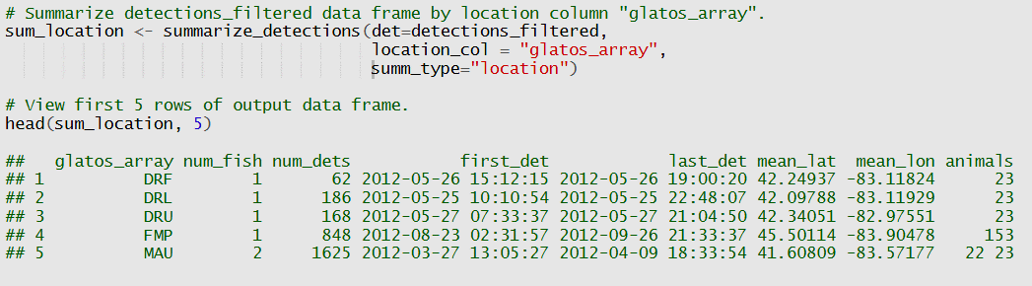
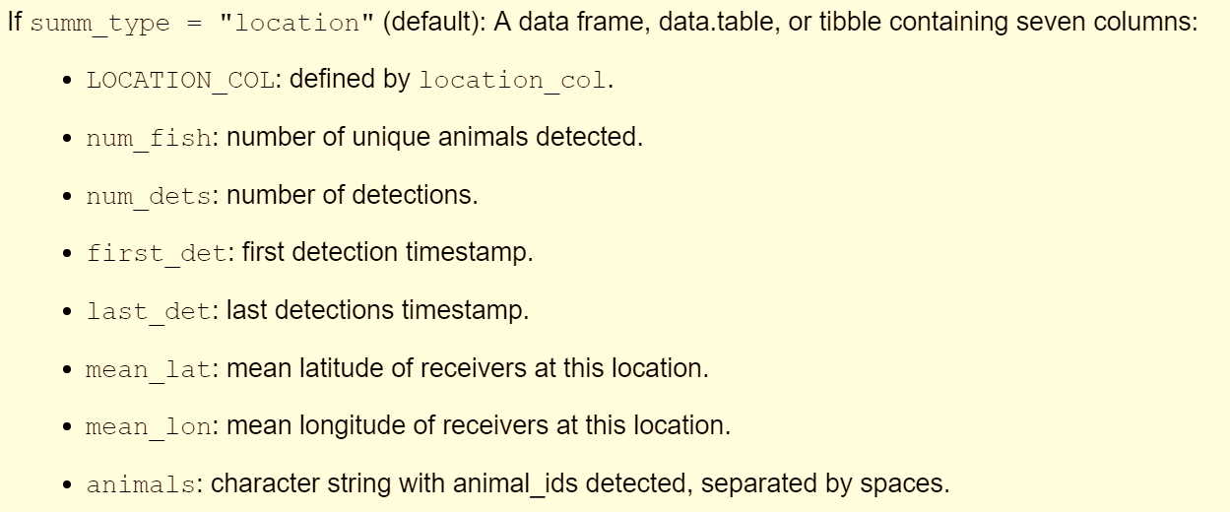
pg: 69
Tabular Summaries of Detections
2. Summarize by “location”

Slide 23
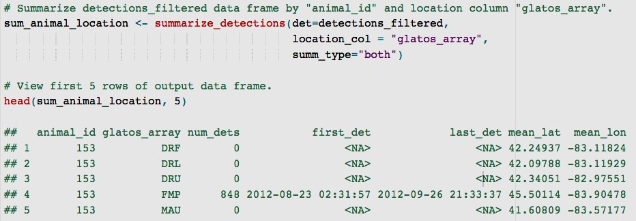
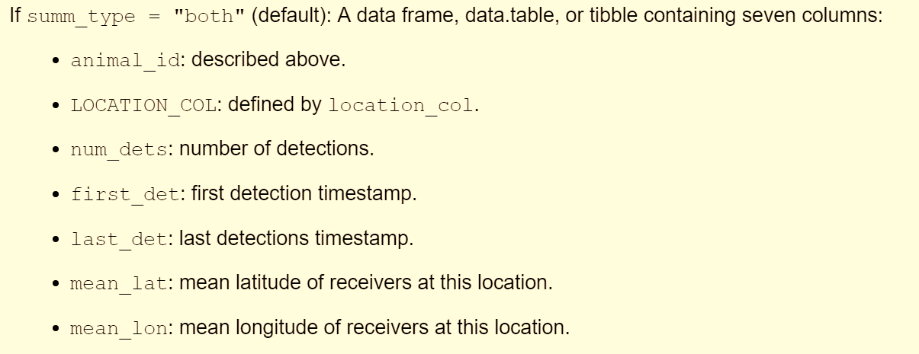
pg: 69
Tabular Summaries of Detections
3. Summarize by “animal” and “location”
NA because this fish was not detected at this location

Slide 24
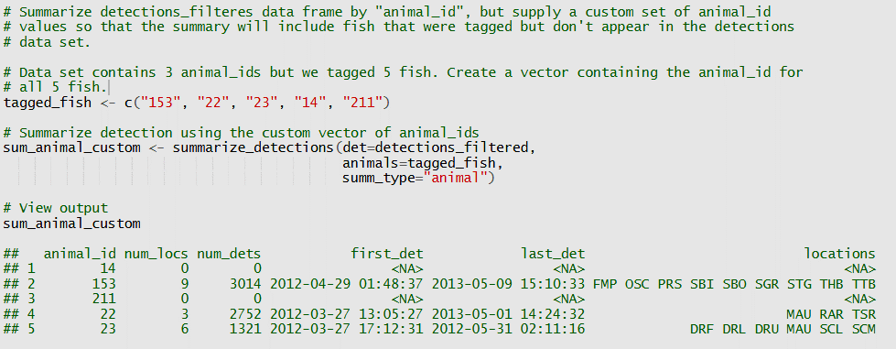
pg: 69
Tabular Summaries of Detections
4. Summarize by “animal”, but supply a custom list of “animal_id” values (to account for fish that may not have been detected)
Note: These fish were tagged but not detected

Slide 25
pg: 72
Reduce Detections to Detection Events
Detection data can contain a lot of redundant information (e.g., 1000s of repeated detections at a single location)
Redundant detections often unnecessary for analyses
Redundancy can make detection files very large and difficult to handle (especially in software like MS Excel)
detection_events function reduces detection data to a series of distinct detection events, characterized by an arrival time (start) and a depart time (end) – new event begins when fish moves to a new location OR returns to the same location after being absent for a user-defined time interval
Speeds up analyses by decreasing computational burden
Makes telemetry data easier to use in programs like MS Excel

Slide 26
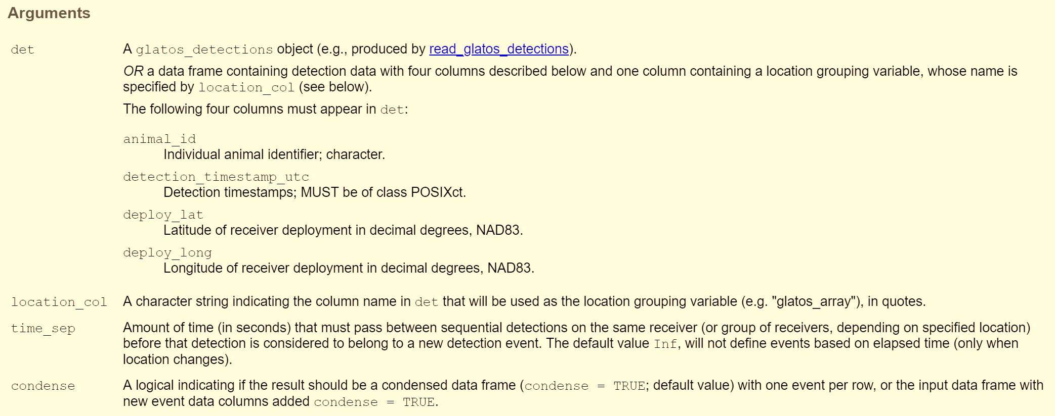
pg: 72
Reduce Detections to Detection Events
detections data frame
detection_events
data frame with detections distilled to events OR 4 additional columns appended to detections data frame
Create a new data frame with each row corresponding to a separate detection event (condense=TRUE) OR add additional columns to current data frame assigning each detection to a detection event and flagging start and end detections for each event (condense=FALSE)
The time in seconds a fish must not be detected at a location before the next detection at that location will be considered a detection new event

Slide 27
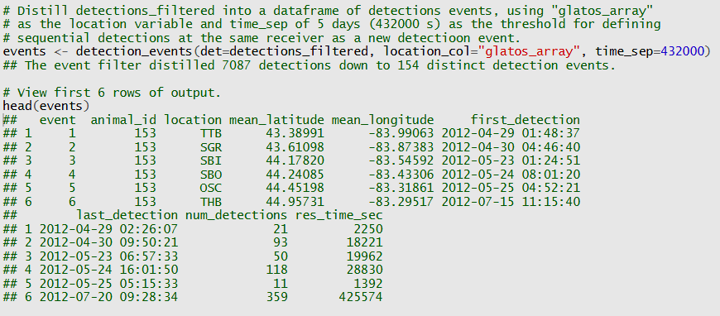
pg: 72
Reduce Detections to Detection Events
By default, condense=TRUE - creates a condensed data frame where each row corresponds to single detection event
97.8 % reduction in # of rows in data frame

Slide 28
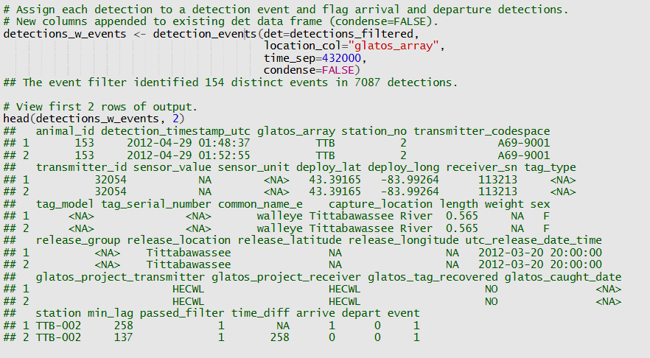
pg: 72
Reduce Detections to Detection Events
When condense=FALSE, columns added to det specifying which event the detection belongs to and flagging the arrival and departure detections for each detection event

Slide 29
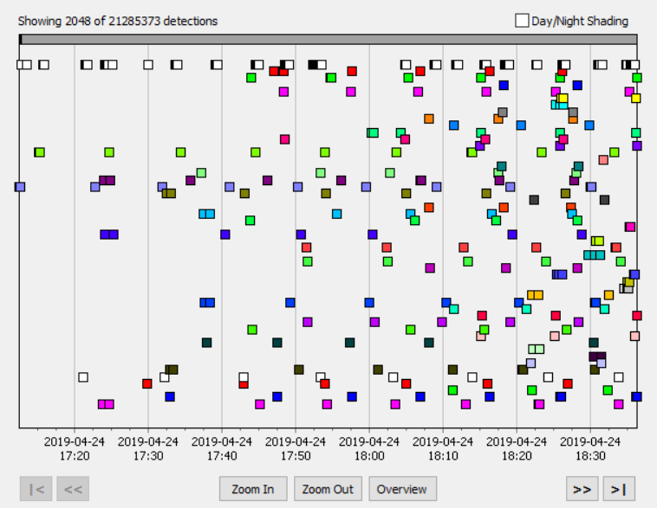
pg: 74
Abacus Plots: Visualizing Individual Detection Histories
abacus_plot allows users to quickly visualize individual detection histories (i.e., detections over space and time)
Similar to charting feature in VUE, but more customizable
Abacus plots are excellent for:
Looking for patterns in detection data
Individual patterns of behavior (e.g., repeated behavior)
Common patterns among individuals
Identifying potential study design issues, equipment failures, and analysis challenges
Communicating individual behavior patterns to others (e.g., presentations or papers)

Slide 30
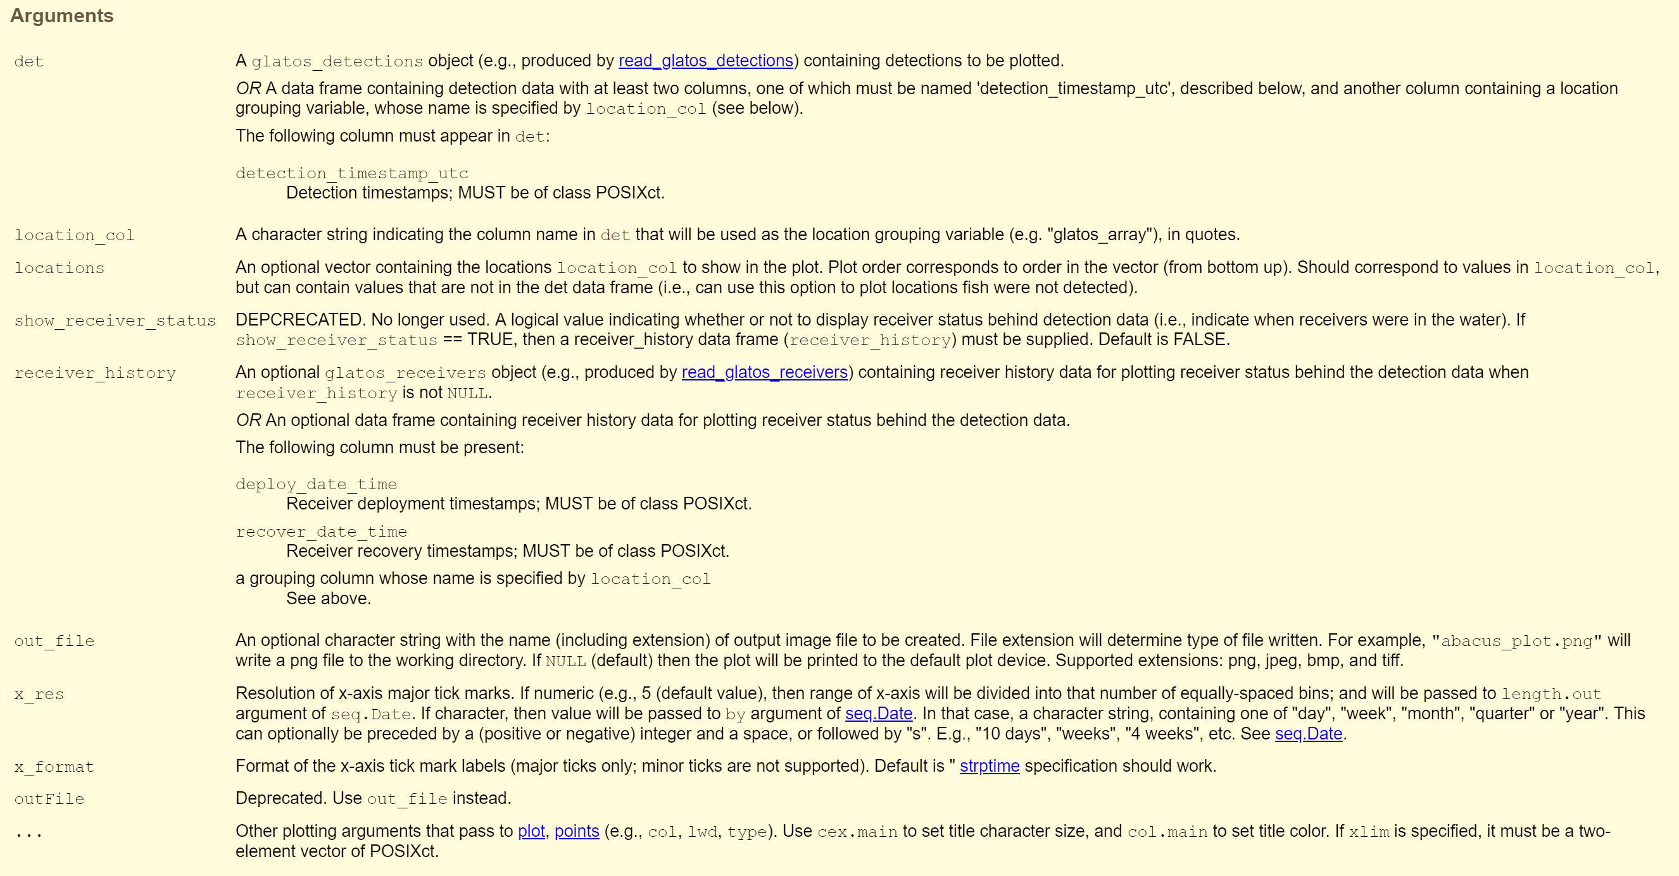
pg: 74
Abacus Plots
detections data frame
abacus_plot
abacus plot showing detections over time at a series of locations

Slide 31
pg: 38-41
Aside: Plotting Arguments (…)
abacus_plot and other functions in the glatos R package call functions from other R packages (e.g., plot, points)
… (elipsis) argument allows you customize outputs by passing a variable number of optional arguments through to these other functions
The help documentation for each function indicates to which functions “…” arguments are passed (e.g., in abacus_plot, … arguments are passed to plot and points)
Click the provided links or type “?function_name” into the R console to open that function’s help page and view what arguments are available

Slide 32
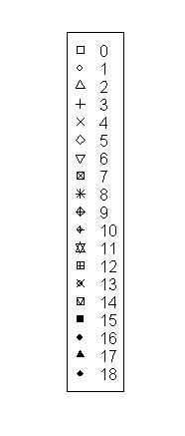
pg: 38-41
Aside: Plotting Arguments (…)
Some common plotting arguments:
main (character): title at top of plot (e.g., main=“TagID: 34567”)
xlab, ylab (character): labels for x and y axes (e.g., xlab=“Length (m)”
xlim, ylim (numeric vector): x and y limits to be displayed on plot (e.g., ylim=c(0,100))
type (character): type of plot drawn (e.g., type=“p” for points, type=“l” for lines, type=“b” for both points and line)
pch (numeric): change the symbol type of a plot (e.g., pch=16)
col (character or hexadecimal code): changes the color of plotted objects (e.g., col=“red”)
cex (numeric): relative (to 1) magnification of plotted objects and text (e.g., cex=2)
?plot, ?points, ?par for more plotting arguments
pch symbols

Slide 33
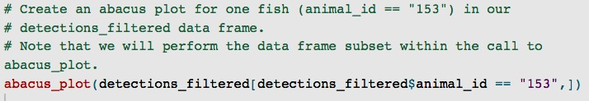
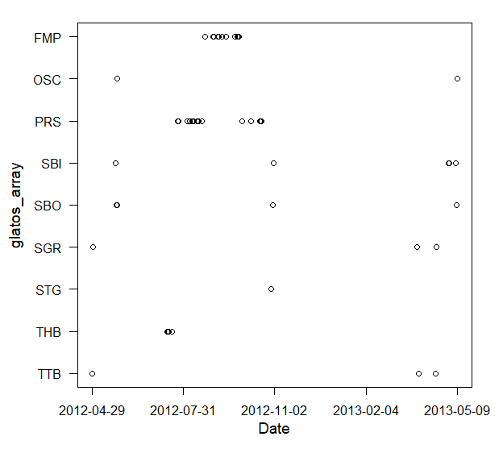
pg: 74
Abacus Plots: Default
Note: No zeros – default only plots locations that are in detections data frame

Slide 34
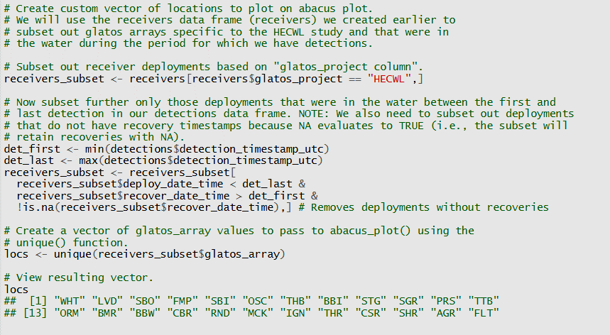
pg: 74
Abacus Plots: Custom Locations
First detection
Last detection
Deployment
Recovery

Slide 35
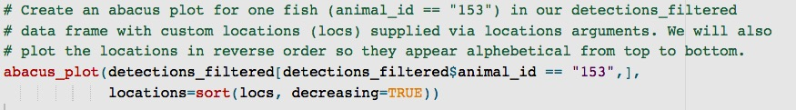
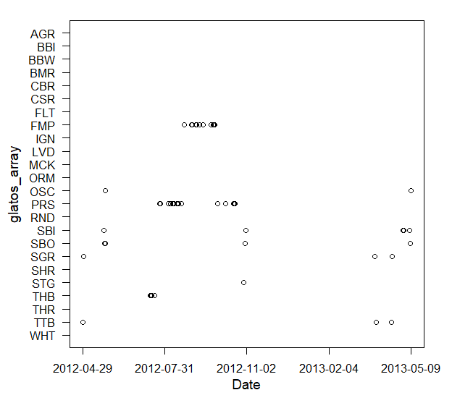
pg: 74
Abacus Plots: Custom Locations
Note: Locations show up on y-axis in order they appear in locations vector (from bottom to top)

Slide 36
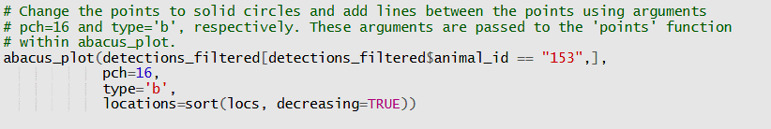
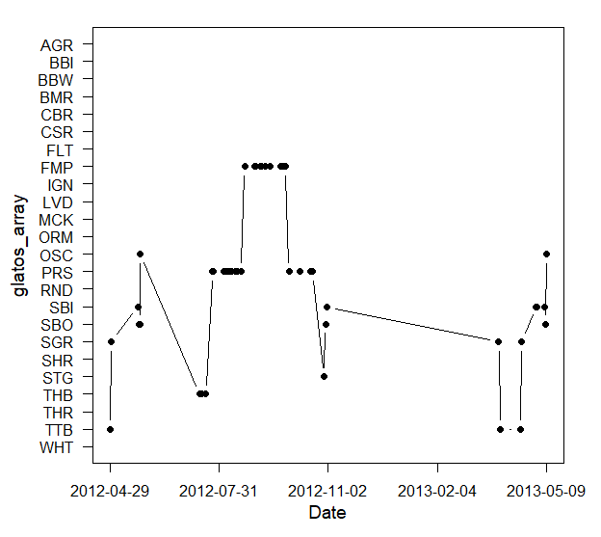
pg: 74
Abacus Plots: Custom Plot Arguments

Slide 37
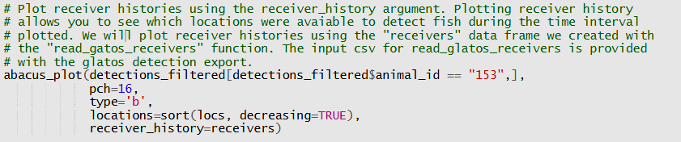
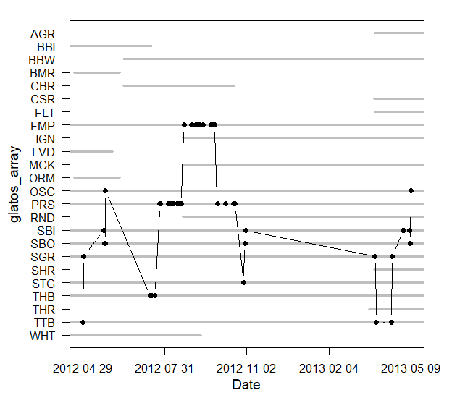
pg: 74
Abacus Plots: Add Receiver History
Note: Grey horizontal lines indicate that receiver data are available during that period for that location

Slide 38
pg: 76
Bubble Plots: Visualizing Spatial Distribution of Fish
detections_bubble_plot allows users to quickly visualize spatial detection patterns of fish in their data set
Circles (bubbles) are plotted at user-defined locations and are shaded according to the relative number of unique individuals that were detected at that location
The size of plotted circles is user-customizable, but currently all plotted circles are the same size (i.e., bubble size does not vary as a function of the number of individuals detected).
Bubble plots are excellent for visualizing the spatial distribution of tagged fish in the system, but are limited in their ability to provide information about the timing of detections
Bubble plots can be used to visualize changes in the distribution of fish over time when separate plots are created for each time period of interest

Slide 39
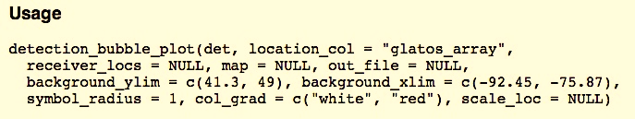
pg: 76
Visualizing Spatial Distribution of Fish
detections data frame
summarize_detections
detection_bubble_plot
data frame with summary of detection data by location + bubble plot showing the spatial distribution of detections
Main arguments
Plot customization arguments

Slide 40
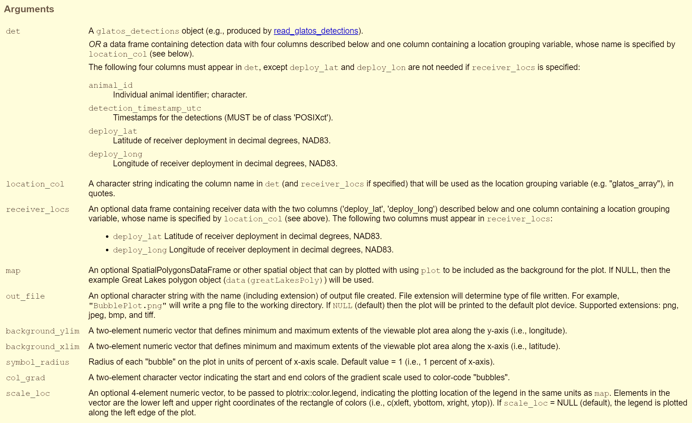
pg: 76
Visualizing Spatial Distribution of Fish

Slide 41
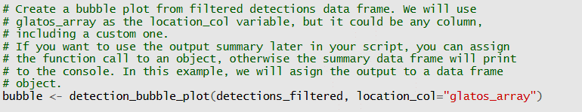
pg: 76
Visualizing Spatial Distribution of Fish
# unique fish detected
Note: By default, only locations that are present in the detections_filtered data frame are plotted (i.e., no zeros)

Slide 42
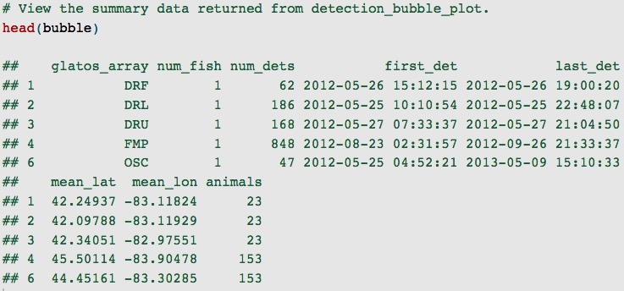
pg: 76
Visualizing Spatial Distribution of Fish

Slide 43
pg: 76
Visualizing Spatial Distribution of Fish

Slide 44
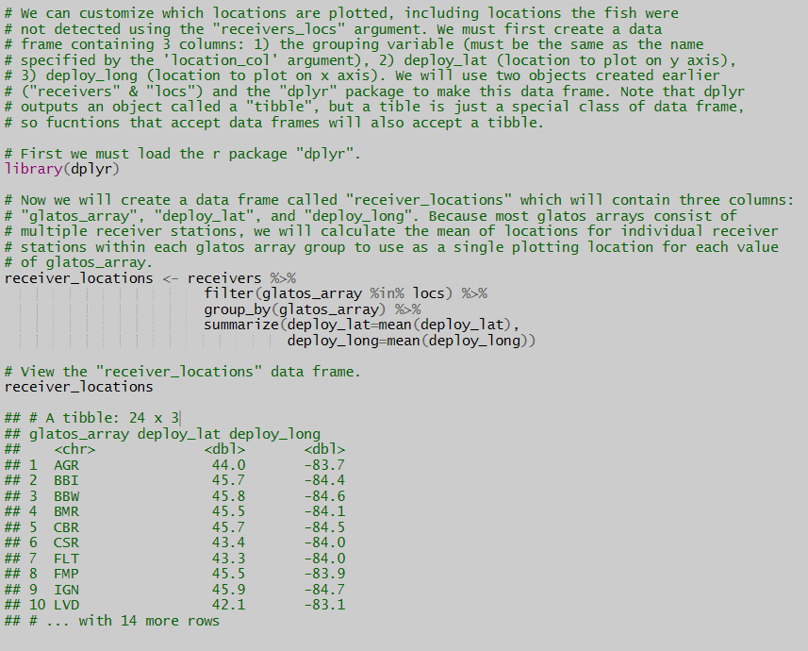
pg: 76
Visualizing Spatial Distribution of Fish
If dplyr has not yet been installed on your computer run
“install.packages(“tidyverse”)” in the console

Slide 45
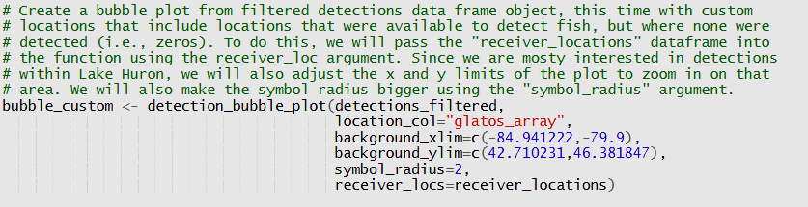
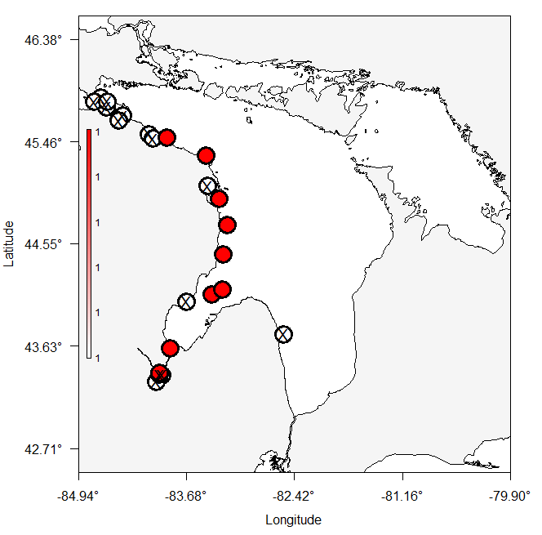
pg: 76
Visualizing Spatial Distribution of Fish

